Slide 1

Capstone Project
2025
Predicting Property Prices in a Specific Location
Using Machine Learning
apstone Project
PRESENTED BY-
DHARMENDRA KUMAR
DIGICROME ACDEMY | c-108, c Block, Sector 02, Noida Utter Pradesh 201301

Slide 2
Project Summary Report Structure
Introduction to the Project
The real estate market is one of the most dynamic and crucial sectors of the global economy, where pricing decisions are often complex and influenced by various factors such as property characteristics, location, market trends, and external conditions. Accurate property price prediction is essential for buyers, sellers, real estate agents, and investors to make informed decisions, ensuring fair transactions and profitable investments.
With the vast amount of real estate data available today, machine learning techniques
can provide significant advantages by analysing historical property data to make reliable predictions about property prices. Traditional methods of valuation are often subjective, while machine learning models can leverage data-driven approaches, offering improved accuracy, speed, and objectivity in estimating property values.
This project focuses on predicting property prices using machine learning algorithms based on data collected for properties within the city of Ames, Iowa, specifically utilizing the Ames Housing dataset. The dataset contains various property features such as property size, year built, quality ratings, number of rooms, neighborhood information, and more. By building a predictive model, the project aims to help real estate professionals, buyers, and sellers make more accurate assessments of property values in a specific location.
The project involves several stages, including data collection, data preprocessing, exploratory data analysis (EDA), feature engineering, model development, and
performance evaluation. The ultimate goal is to create a model that can predict property prices based on these key features, offering insights into the most influential factors and providing a tool that can be applied to new real estate data for future price predictions.
By the end of this project, a machine learning model with an expected accuracy range of 75%-85% in R² score will be developed, which can be deployed for practical use in predicting property prices in real-world scenarios.
2. Objectives of the Project
Outline the specific objectives or goals of the project, ensuring that they cover all major components of the project
1-Collect and clean real estate data for predicting property prices.
Property_data.csv: A file showing the format for submitting predictions.

Slide 3
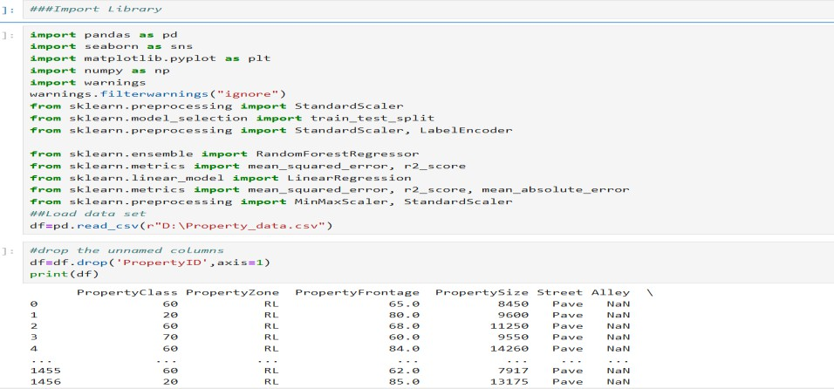
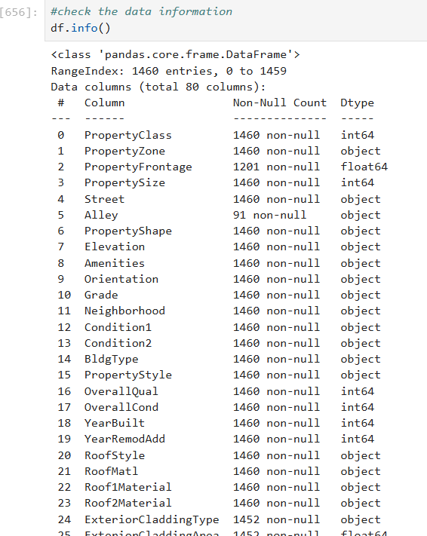
2. Initial Data Inspection
Before cleaning, it's essential to check the data to understand its structure and identity any issues such as missing Value

Slide 4
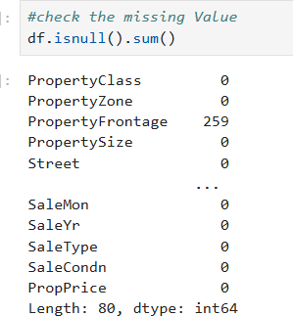
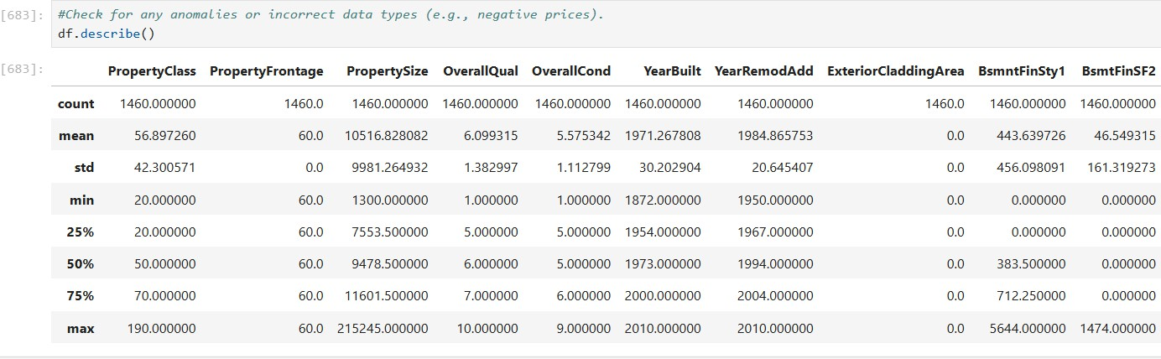
Use, duplicates, and incorrect data types.
3. Handling Missing Values
1- Numerical Features: For columns containing numerical values, you can fill missing values with the median or mean
2- Categorical Features: For columns containing categorical values, you can either fill missing values with the mode

Slide 5
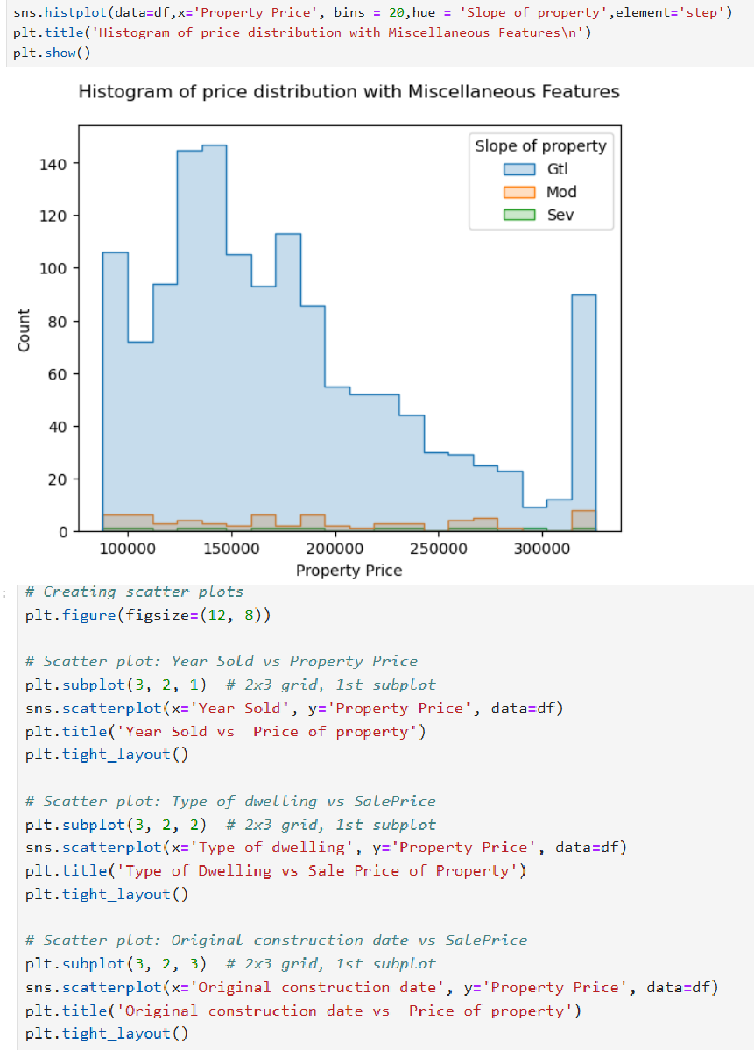
4. Conduct Exploratory Data Analysis (EDA)
Analyse the data using EDA techniques to identify key features and relationships that influence property prices.

Slide 6
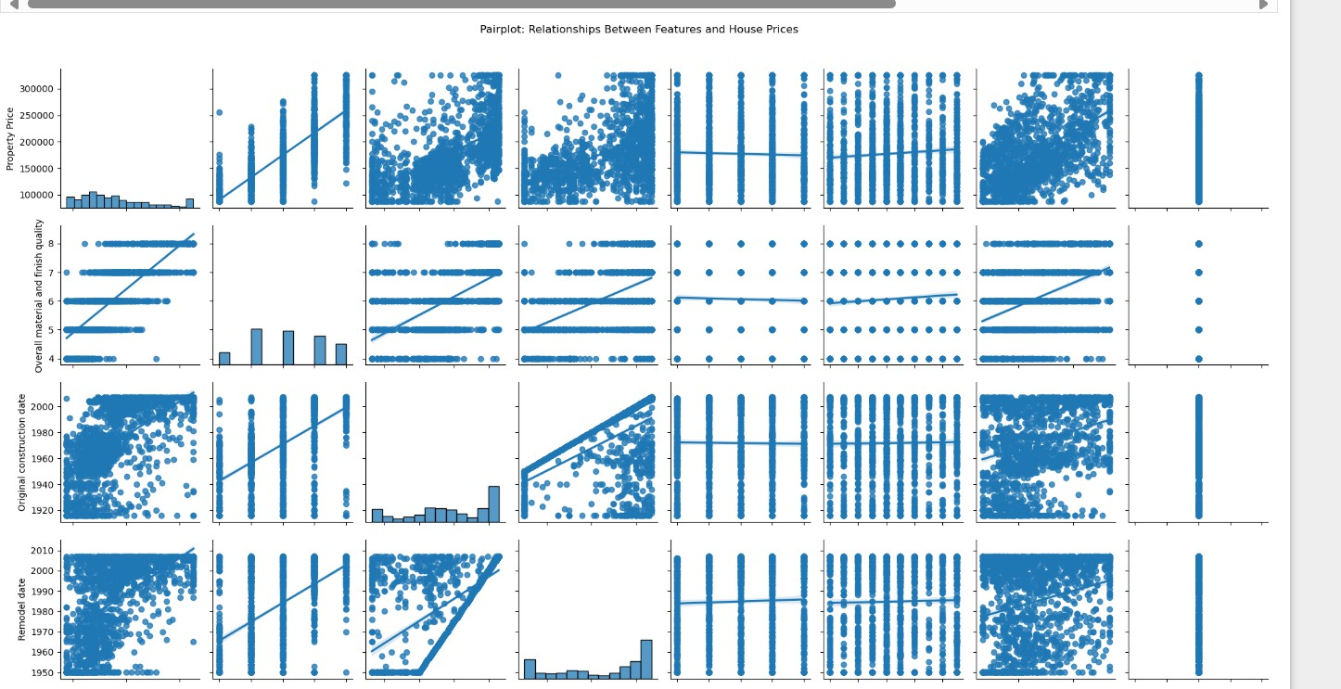
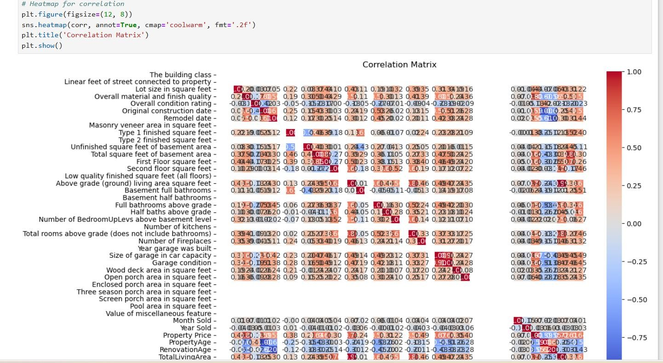
Visualize important features using plots (e.g., correlation heatmaps, histograms) to gain insights into the data.

Slide 7
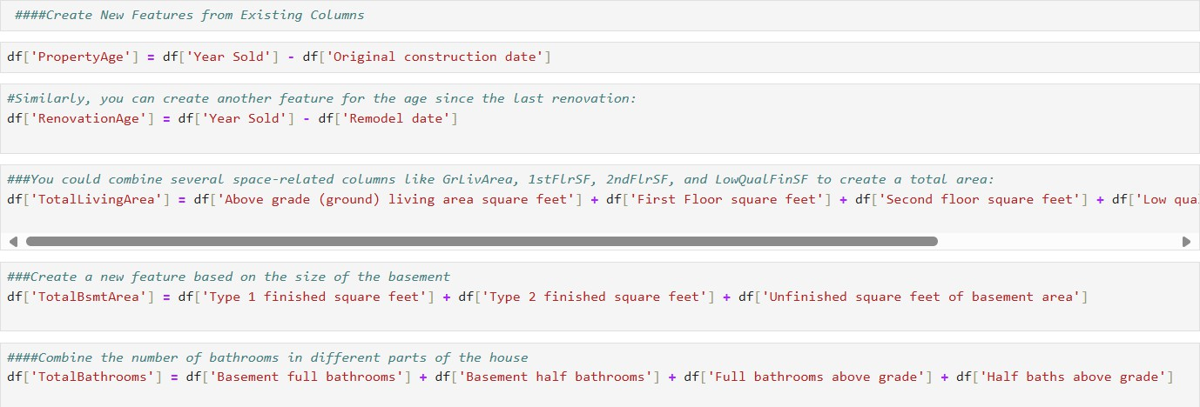
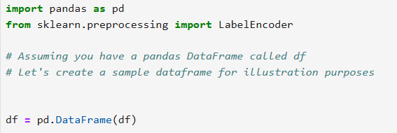
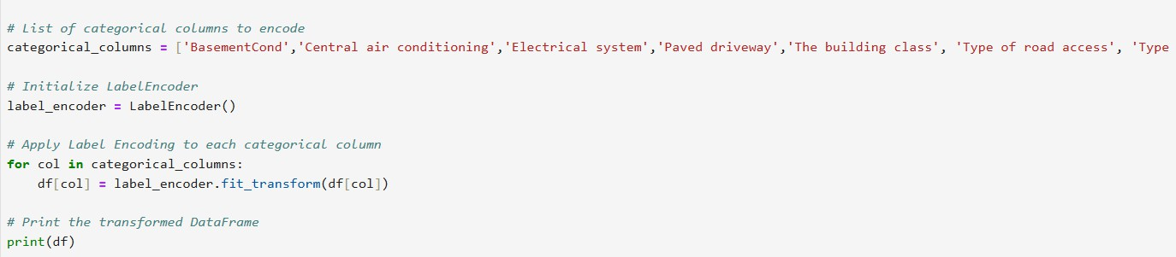
6. Feature Engineering:
Log Transformation of Target Variable: The property prices might be skewed, so it's a good idea to apply a log transformation to the target variable (Sale Price) to rece skewness and improve model performance.
Feature Scaling: Some machine learning models require features to be scaled, especially when dealing with numerical features that vary in scale (e.g., square footage, number of rooms). You can use StandardScaler or MinMaxScaler to scale the features.
6-Select and Apply Encoding Techniques
Machine learning models require numerical inputs, so categorical features must be encoded. Depending on the type of categorical feature, you may choose between label encoding and one-hot encoding.
Ordinal Variables (those with a natural order, such as OverallQual or ExterCond): These can be label-encoded (converting categories to integer labels).
Nominal Variables (those without a natural order, such as Central air condition): Use one-hot encoding to create dummy variables for each category.

Slide 8
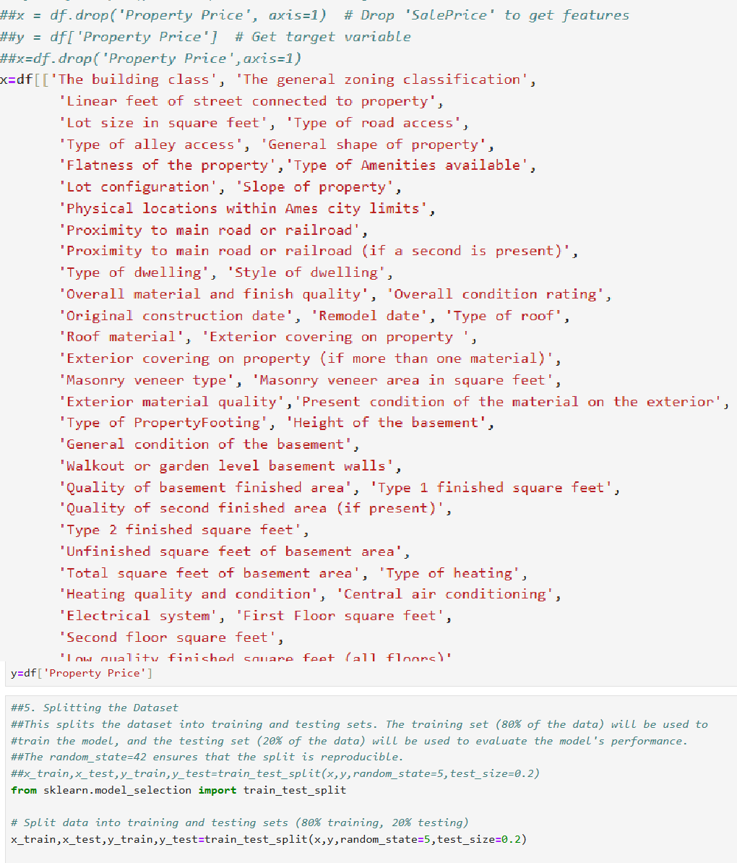
7- Train Multiple Machine Learning Models:
Train and evaluate different machine learning algorithms (e.g., linear regression, decision trees, random forests, and others) to determine the best-performing model for predicting property prices.

Slide 9
from sklearn.ensemble import RandomForestClassifier
rf:RandomPorestClassifier(n_estimators:100,criterion:'entropy ) rf.fit(x_train,y_train)
RandomForestClassifier
RandomForestClassifier(criterion='entropy')
from sklearn.ensemble import RandomForestRegressor model z RandomForestRegressor()
model.{it(x_train,y_trazn)
Randor4ForestRegressor
RandomForestRegressor()
y_pred : model.predict(x test)
y_pred
array([232169.92, | 177509.62, | 186837.11, | 1B3193.08, | 134217.79, | í95979.7,
174531.3, | 124960.33, | 275534.91, | 213824.5, | 138369. , | 161327.&l,
24B9B3.64, | 106335.71, | 166233.34, | 246287.39, | 129211.25, | 151502.27,
193614. , | 225763.67, | 206179.5 , | 251650.8 , | 13606B.05, | 216772.13,
^{r"}• Se1ectF^{- "}roMocIeI^{- •}
estimaior: Lasso :
Lasso
s<learn.tree import DecisionTreeRegressor model4 : DecisionTreeRegressor(random_state:42) model4.fit(x train, y train)
DecisionTreeRegressor DecisionTreeRegressor(random state=42)
E

Slide 10
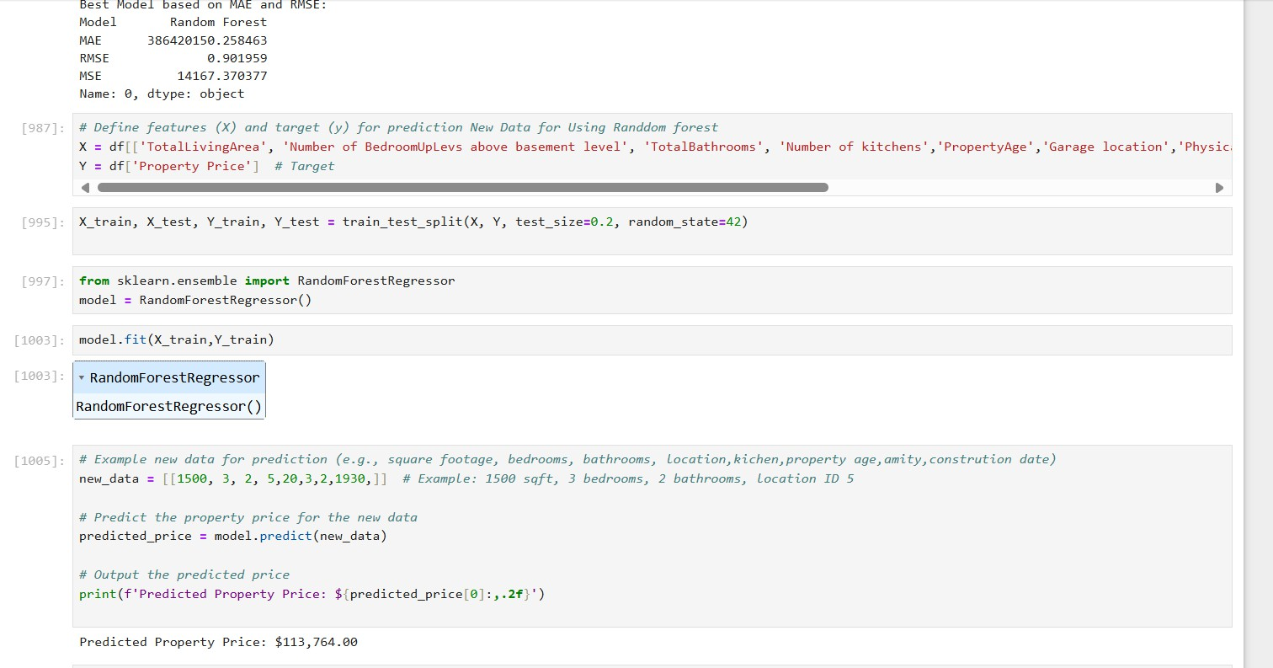
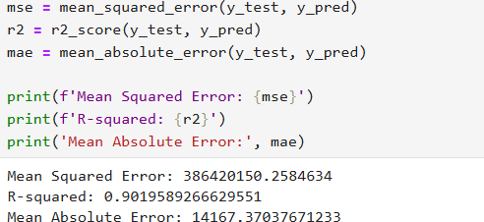
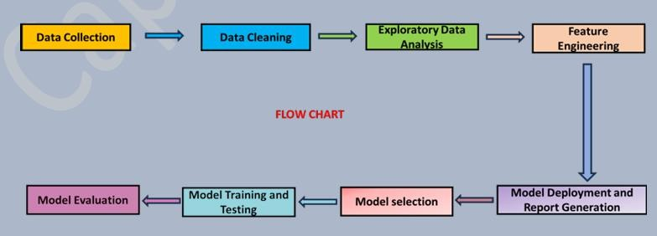
8- Model Evaluation and Performance Assessment:
Evaluate the trained models using performance metrics such as R², Mean Absolute Error (MAE), Root Mean Squared Error (RMSE) to assess their prediction accuracy.
3- Flow Chart of Operations
Here’s a flowchart of the key steps involved in the project:

Slide 11
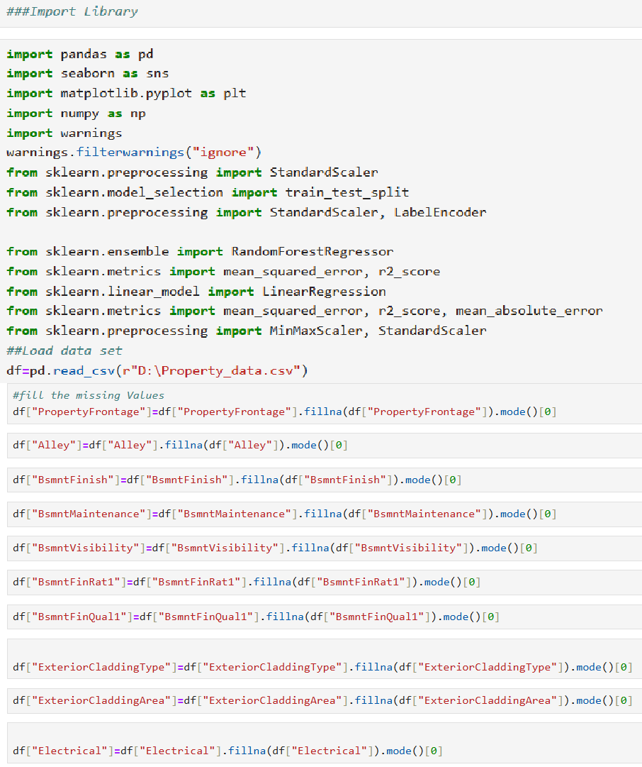
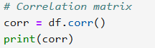
4. Python Codes
In this section, i will provide the relevant Python code used in the project for data preprocessing, EDA, model training, and evaluation. Below is a sample breakdown:

Slide 12
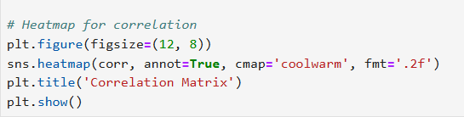
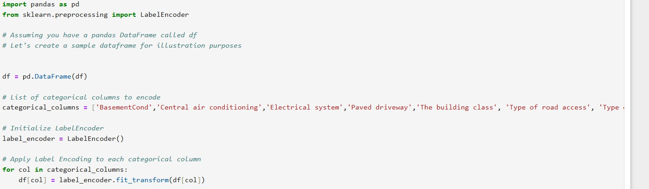
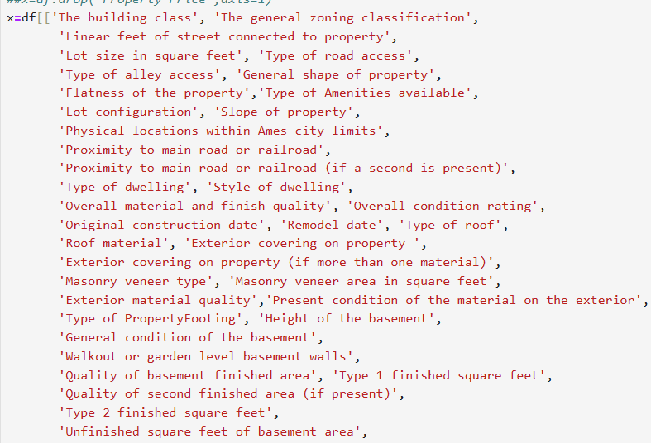
Feature Engineering
# Model training (Random Forest)

Slide 13
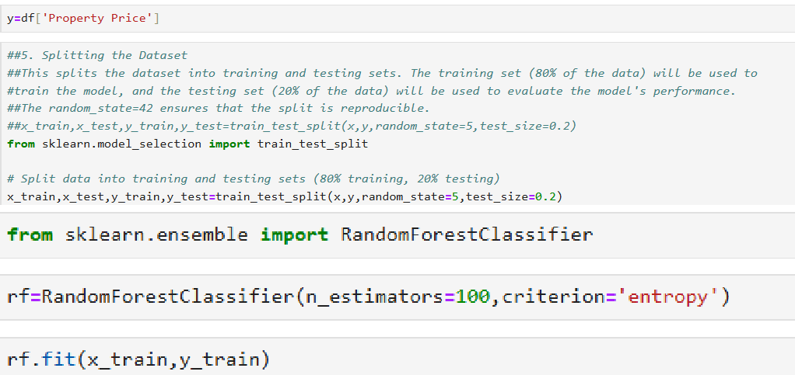
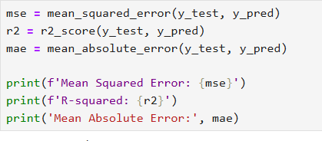
# Predictions and evaluation
Screenshot of the Outputs
The outputs from the Jupyter notebook would include various visualizations and model performance metrics
Correlation Heatmap
A Correlation Heatmap helps to visualize the correlation between various features in the dataset and the target variable (Property Price). By understanding the correlation between different features and the target, we can identify which variables are most strongly related to property prices. This helps in selecting the most important features for building the predictive model.

Slide 14
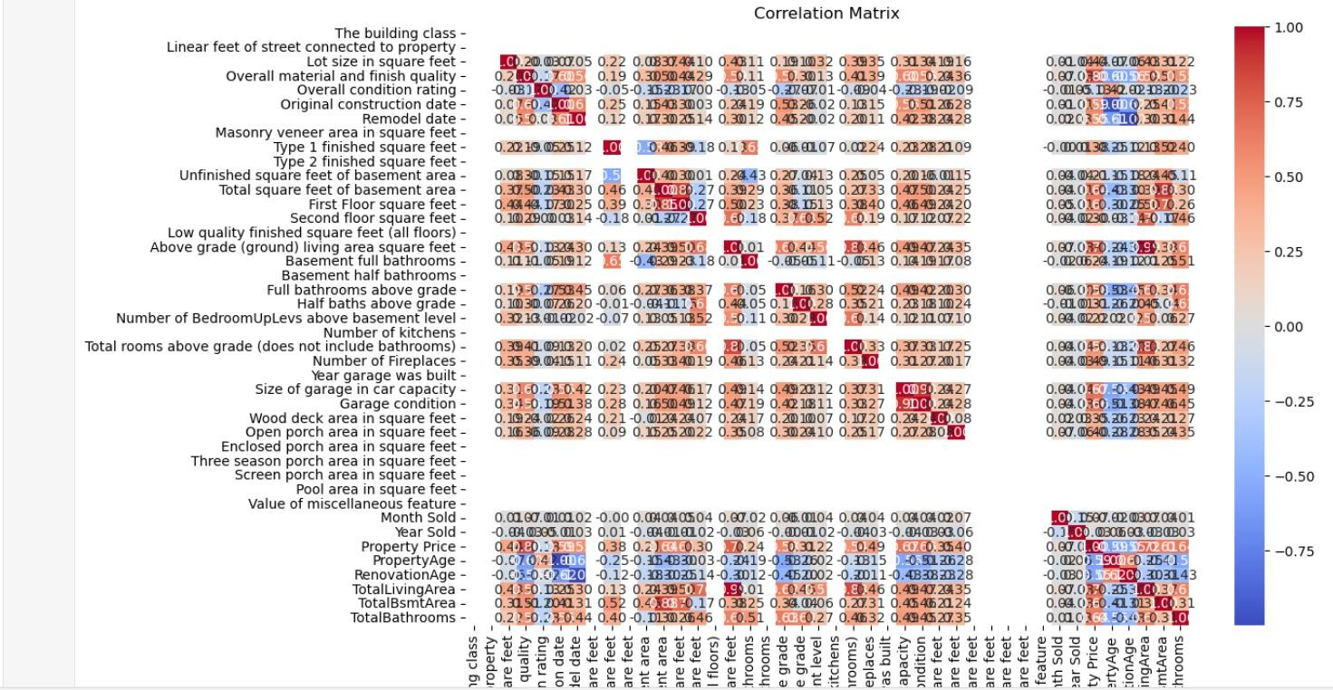
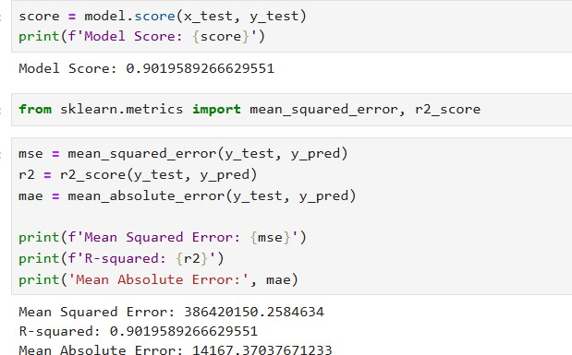
Output 1: Feature Correlation Heatmap
Output 2: Prediction vs Actual Prices (Plot)

Slide 15
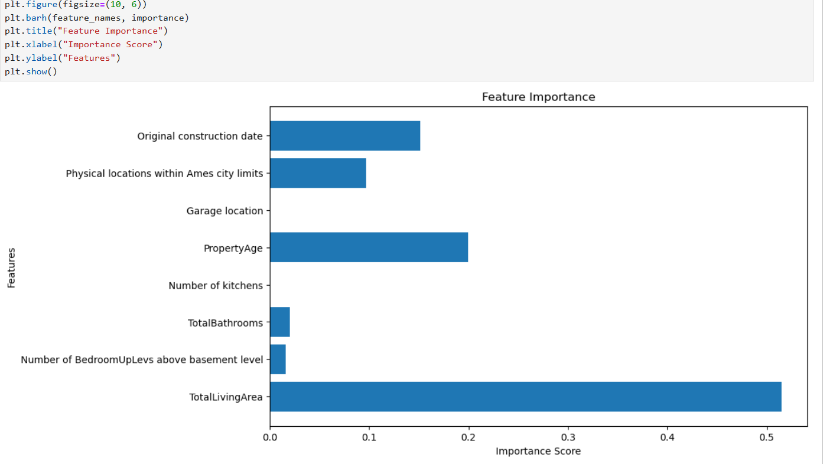
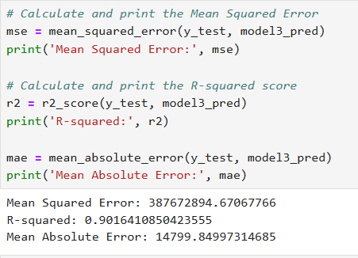
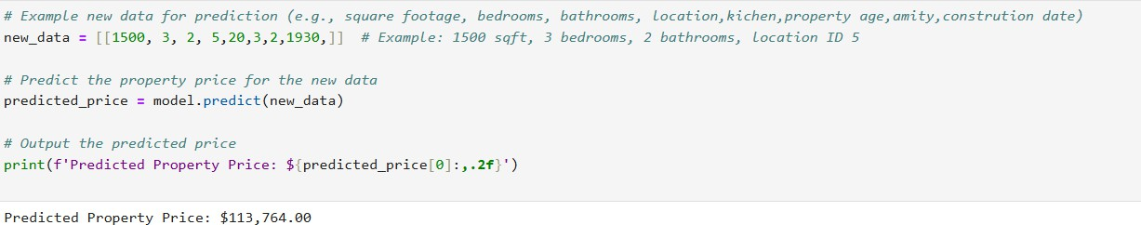
Output 3: Model Evaluation Results

Slide 16
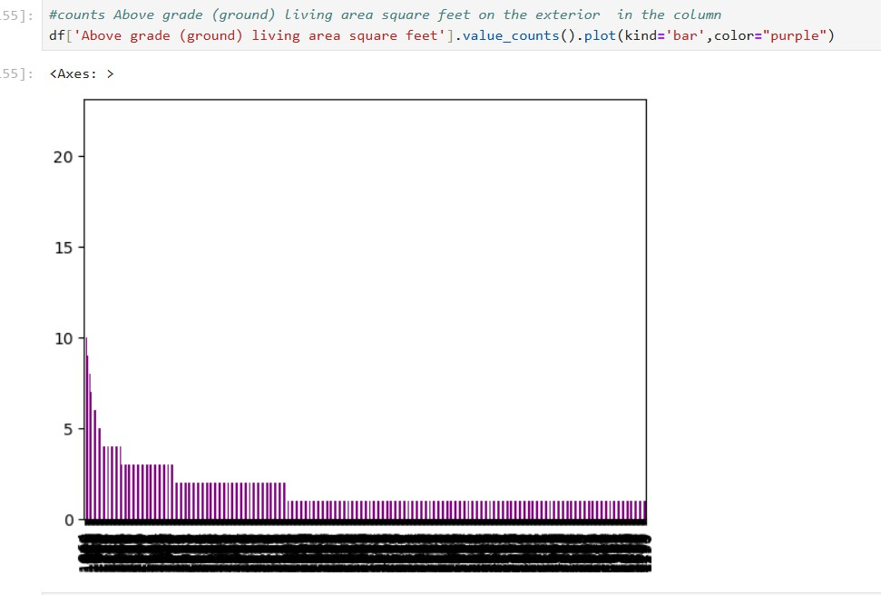
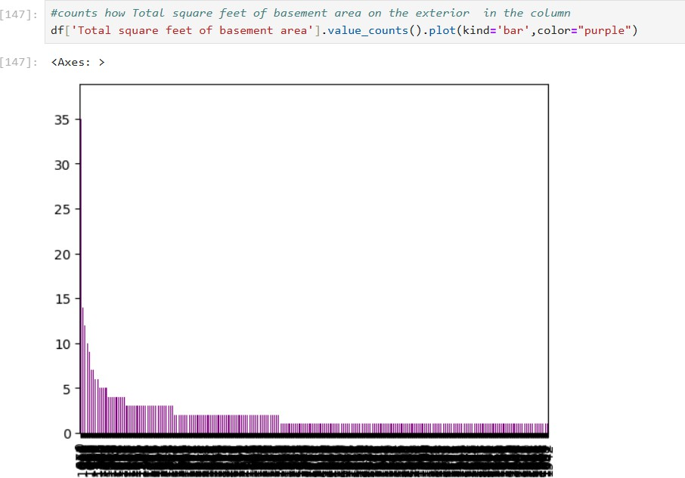
6-Report on EDA
Exploratory Data Analysis (EDA) involves visualizing and understanding the patterns within the dataset. The following key observations were made during EDA
1-Feature Distribution
Above grade living area
Total square feet basement

Slide 17
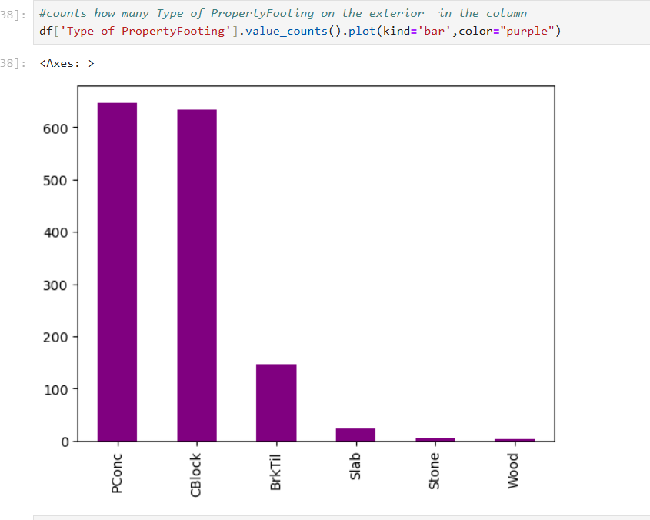
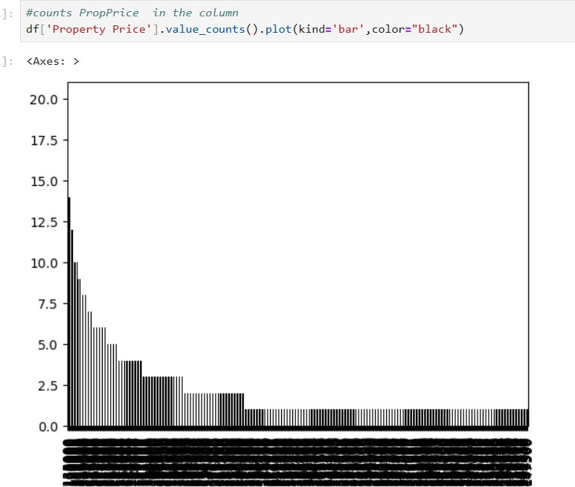
Type of PropertyFooting
Property Price

Slide 18
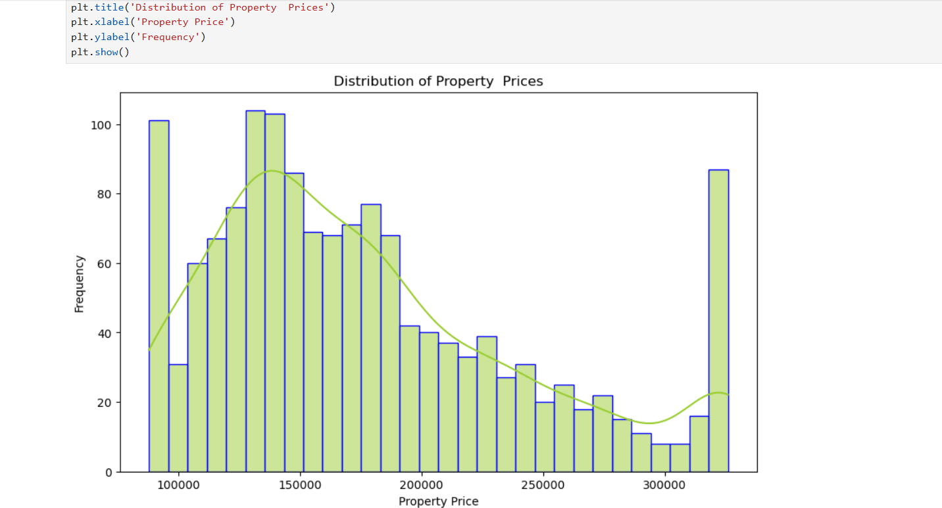
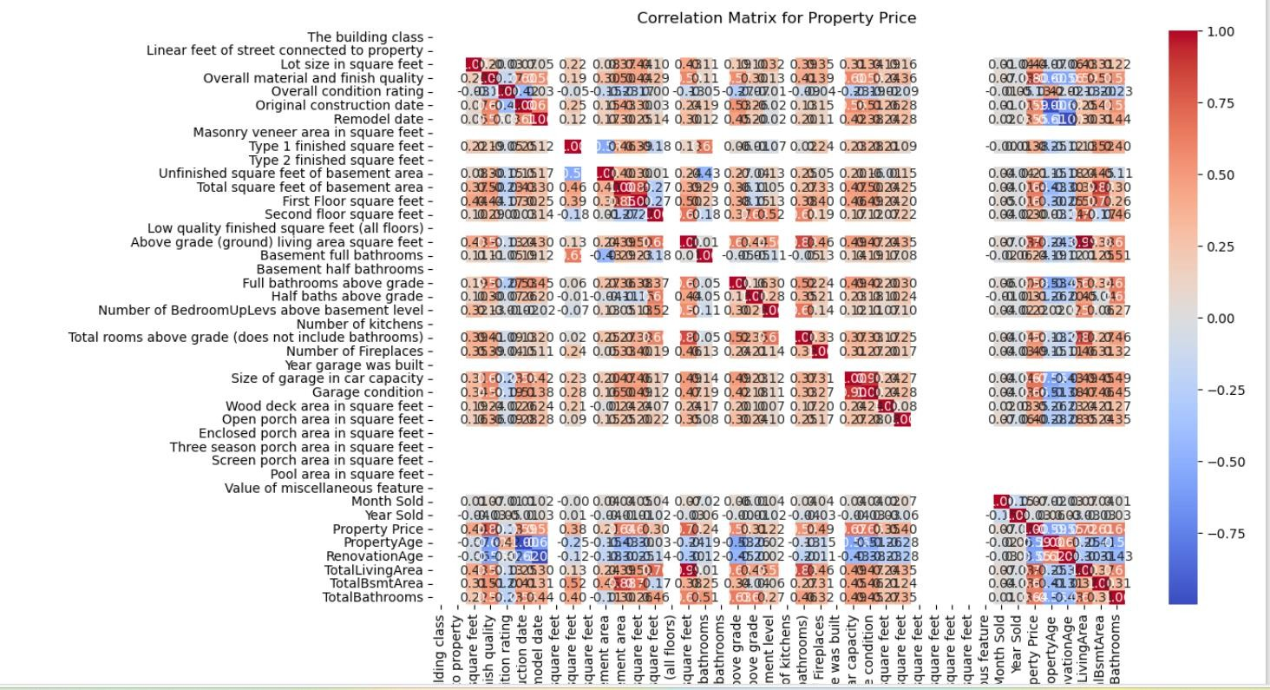
Distribution of Property Prices
2-Correlation Analysis
A correlation heatmap was created to identify which features have the highest correlation with the target variable, Property Price

Slide 19
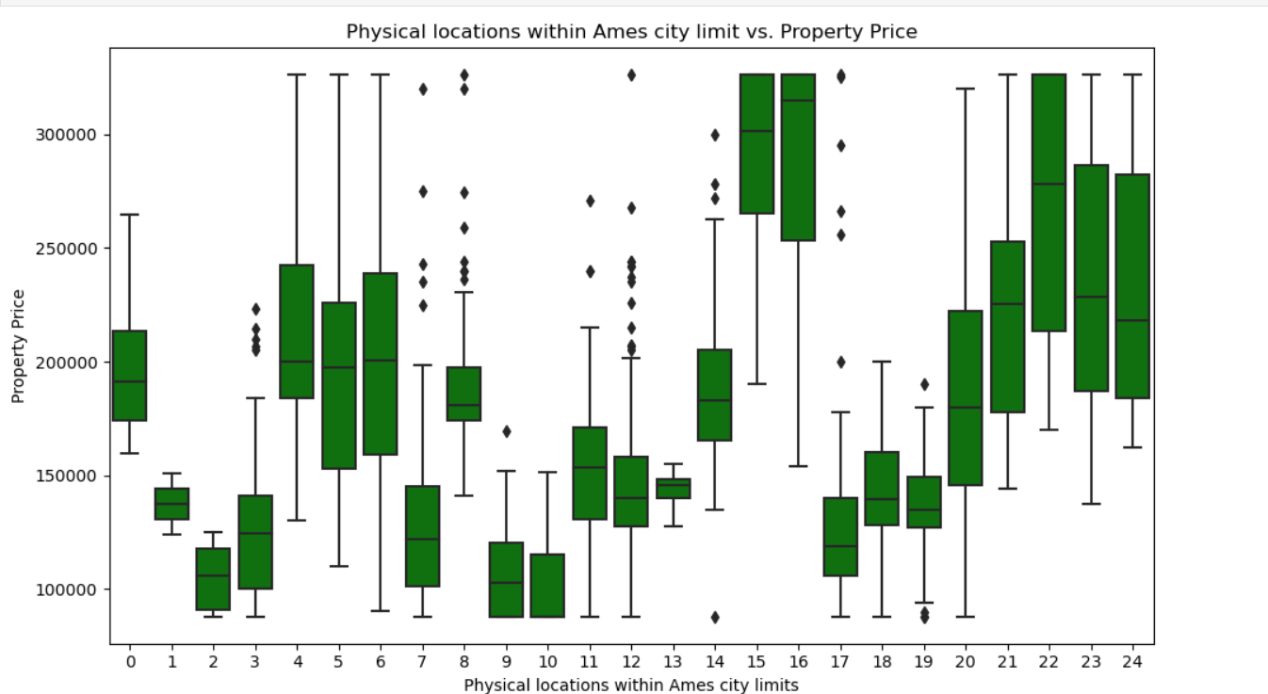
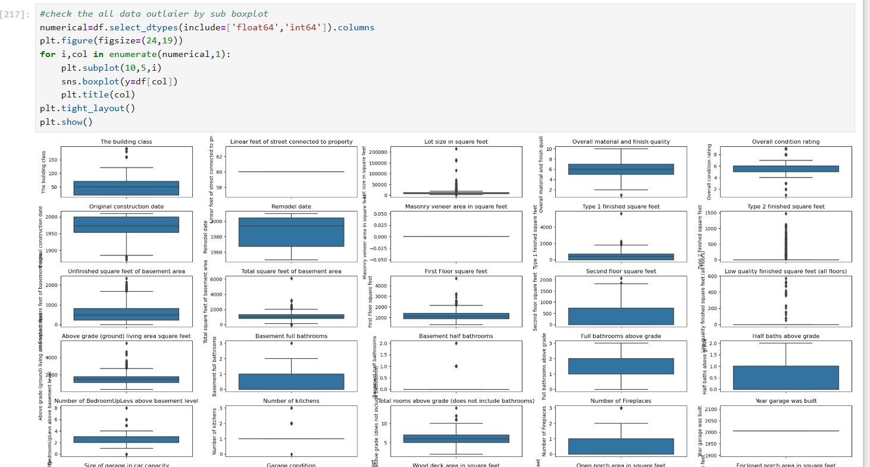
Box Plots: To visualize the distribution of property prices across different Physical location within Ames city limits vs Property Price
Out lair for boxplot

Slide 20
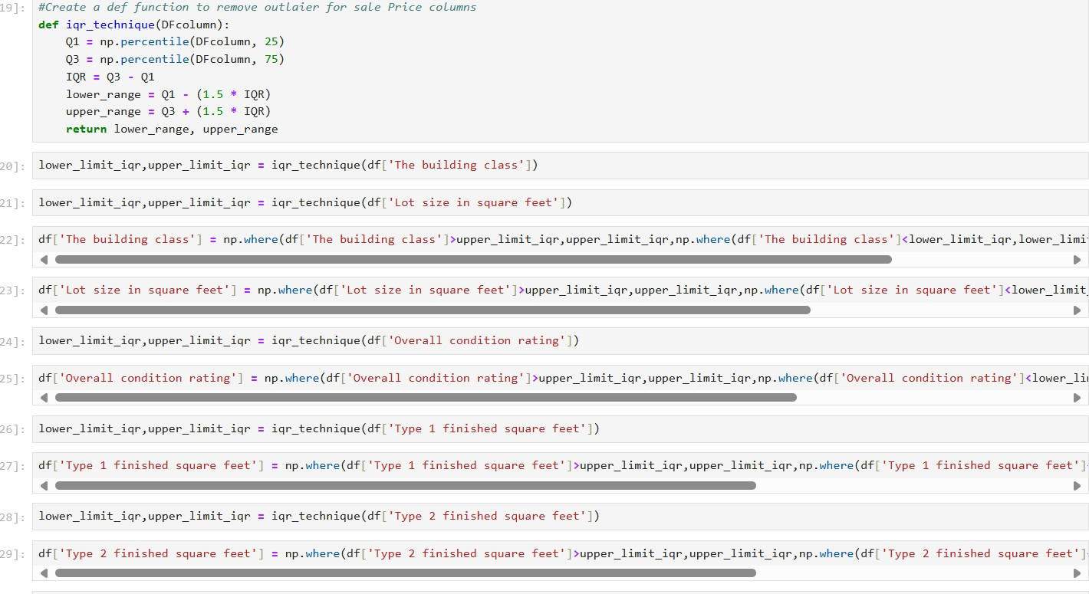
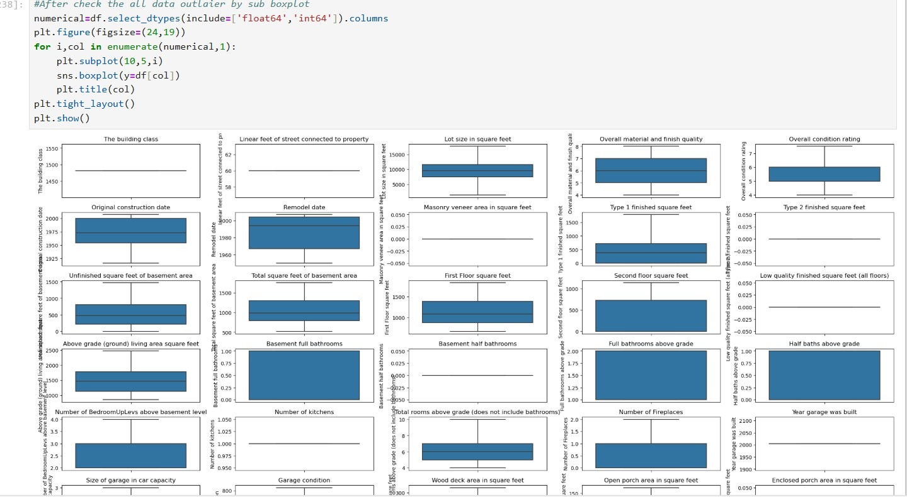
Remove Out lair

Slide 21
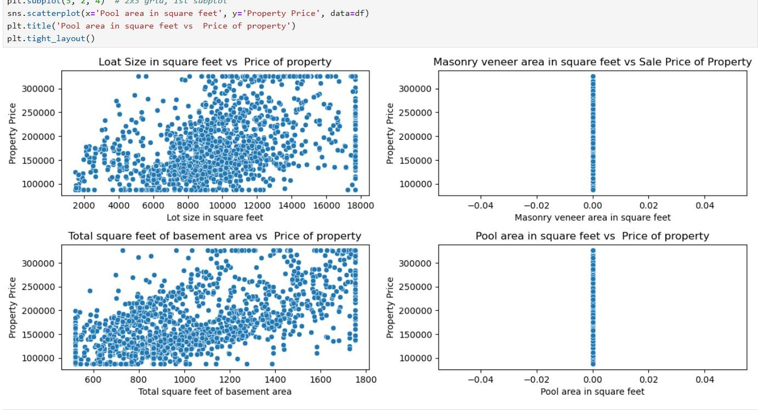
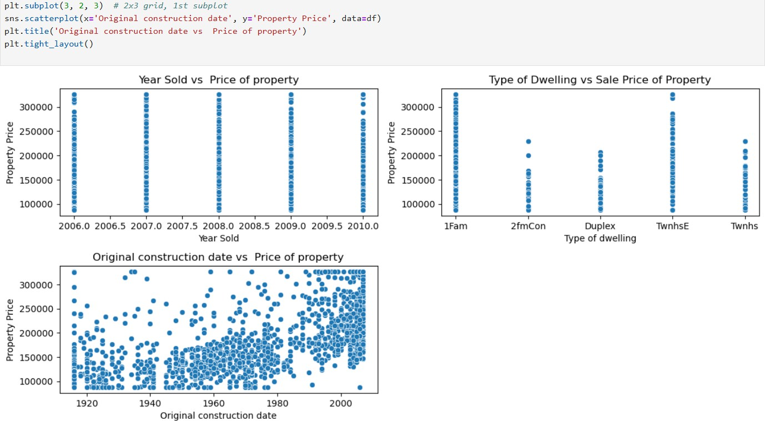
Scatter Plots: To analyse relationships between square footage and price And Original Constructed date
Learning Outcomes
1-Understanding of how to handle both nominal and ordinal categorical variables in machine learning
Handling Nominal and Ordinal Variables:
I learned how to handle both nominal (categorical variables with
no inherent order, such as Lot size in square feet, Street, and Type of sale) and ordinal variables (categorical variables with an inherent order, such as Present condition of the material on the

Slide 22
exterior, Kitchen quality, and Overall material and finish quality). For nominal variables, techniques like one-hot encoding are used, while for ordinal variables, label encoding or custom ordinal encoding can be applied to maintain the natural order.
Feature Engineering and Encoding:
I gained a deeper understanding of how to properly encode these variables to make them usable for machine learning models. Ordinal encoding ensures that relationships between categories are preserved, whereas one-hot encoding helps in representing nominal variables as binary features. This distinction is crucial when building a model, as treating an ordinal variable as nominal might lead to loss of useful information about the order of the categories
Practical Applications of Encoding Techniques:
I also learned the importance of using techniques like LabelEncoder and OneHotEncoder from libraries like Scikit-Learn and how to select the appropriate encoding strategy based on the type of categorical variable.
2-Gained experience in using data preprocessing techniques such as scaling, handling missing data, and PCA to improve model performance.
By completing this project, I gained valuable experience in using various data preprocessing techniques to improve model performance:
Scaling:
I learned the importance of scaling numerical features, especially when dealing with algorithms like Linear Regression and Support Vector Machines that are sensitive to the scale of the data. By using
StandardScaler from Scikit-Learn, I was able to standardize the features, ensuring that all variables have a mean of 0 and a standard deviation of 1. This helps the model converge faster and improves accuracy, especially when features have different units or magnitudes (e.g., Lot Size in Square Feet in square feet vs. Original Constructed date in years).
3- Ability to perform exploratory data analysis to uncover patterns and important variables in a dataset.

Slide 23
By completing this project, I developed the ability to perform exploratory data analysis (EDA), which helped uncover valuable patterns and identify important variables in the dataset. Here are the key insights and techniques I learned during the process:
Data Visualization:
I became proficient in using data visualization tools like matplotlib and seaborn to create various plots that helped in understanding the data. For example:
Histograms to visualize the distribution of the target variable (Property Price) and understand its spread.
Boxplots to detect outliers in features like GrLivArea and OverallQual.
Correlation heatmaps to identify relationships between numerical features and the target variable. This helped me pinpoint which features, such as Above grade (ground) living area square feet, TotRmsAbvGrd, and Original Constructed date, had strong correlations with property prices.
Univariate and Bivariate Analysis:
I learned how to analyse individual features (univariate) as well as the relationship between two variables (bivariate). For example:
Examining the distribution of categorical variables like Physical locations
within Ames city limits helped me understand how property prices vary across different areas.
Scatter plots and pairplots were used to explore relationships between multiple features (e.g., Overall material and finish quality vs. Property Price), which
revealed how higher-quality properties generally led to higher prices.
Handling Missing Data:
During the EDA phase, I discovered columns with missing data. I then applied imputation techniques to fill in the missing values, ensuring the dataset remained consistent and usable for modelling.
Feature Importance:
Through EDA, I identified key features that directly impact property prices, such as
Overall material and finish quality, Above grade (ground) living area square feet, and
Original Constructed date . Understanding these relationships allowed me to focus on the most influential variables during feature engineering and model selection.
Identifying Outliers:
I also learned to spot and handle outliers, especially in features like Lot configuration
and Above grade (ground) living area square feet, which could have distorted the model if left untreated. I used boxplots and z-scores to identify and address extreme values.

Slide 24
Overall, EDA was instrumental in uncovering underlying patterns and insights in the dataset, helping me make informed decisions about which features to include and how to preprocess the data. This phase provided the foundation for building a robust predictive model by highlighting key variables that influence property prices.
4-Familiarity with using different machine learning algorithms (Linear Regression, Random Forest, etc.) and comparing their performances based on metrics like R2 score, MAE, and RMSE
By completing this project, I gained familiarity with using different machine learning algorithms, including Linear Regression and Random Forest, and developed the ability to compare their performance based on key metrics like R2 score, Mean Absolute Error (MAE), and Root Mean Squared Error (RMSE). Here’s what I learned during the process:
Linear Regression:
Linear Regression is a simple algorithm used for predicting a continuous target variable (like property price) based on one or more independent features.
Model Fitting: It assumes a linear relationship between the independent variables and the target variable. The model works by minimizing the sum of squared errors between the predicted and actual values.
Performance Metrics:
R2 Score: The R2 score for Linear Regression provided an understanding of how much variance in property prices was explained by the model. A higher R2 score indicates a better fit.
MAE: The Mean Absolute Error measured the average magnitude of the
prediction errors. It helped me understand how far off the model’s predictions were from the true values on average.
RMSE: The Root Mean Squared Error penalized larger errors more than MAE and helped indicate how well the model performed with respect to outliers.
Random Forest:
Random Forest is an ensemble learning method that creates a forest of decision trees and combines their outputs to improve prediction accuracy.
Model Fitting: This algorithm builds multiple decision trees on random subsets of the data and averages their predictions. This helps to reduce overfitting and improve
model robustness.
Performance Metrics:
R2 Score: The Random Forest model generally produced a higher R2 score compared to Linear Regression, indicating that it explained more of the variance in property prices.
MAE: The MAE for Random Forest was lower, reflecting more accurate predictions on average.
RMSE: The RMSE for Random Forest was also lower, suggesting that it better handled outliers and large prediction errors compared to Linear Regression.

Slide 25
Comparison of Performance:
By comparing the performance of Linear Regression and Random Forest on the same dataset, I learned the following:
Random Forest was able to capture more complex, non-linear relationships between the features and the target variable, leading to a better fit and lower prediction errors (as reflected in higher R2 scores and lower MAE and RMSE).
Linear Regression, although useful and interpretable, performed worse because of its assumption of linearity, which didn't fully capture the complexity of the property price data.
R2 Score was a good overall indicator of model fit, but MAE and RMSE provided more detailed insights into the magnitude of the model's errors and its ability to
handle outliers.
Key Insights:
Linear Regression works well when the relationship between variables is linear and there are fewer outliers, but it struggles with more complex datasets where non-linear relationships exist.
Random Forest outperformed Linear Regression by being able to model complex, non-linear patterns and handle outliers more effectively.
By comparing these two algorithms using R2, MAE, and RMSE, I was able to make informed decisions on selecting the better model, which in this case was Random Forest.
5- Improved my knowledge of feature engineering and model evaluation techniques, and how to interpret the results of a machine learning model
By completing this project, I improved my knowledge of feature engineering and model evaluation techniques, as well as how to interpret the results of a machine learning model. Here's a detailed overview of what I learned:
Feature Engineering:
2. Model Evaluation Techniques
3. Interpreting Model Results
Conclusion
This capstone project successfully demonstrated the application of machine learning techniques to predict property prices using various attributes such as property size, neighborhood, amenities, and more. The project involved critical steps like data collection, preprocessing, feature engineering, and model evaluation, culminating in the development of a robust predictive model.
Key outcomes include:
Data Preprocessing: Through techniques such as scaling, handling missing data, and dimensionality reduction (PCA), I was able to clean and prepare the dataset effectively, ensuring optimal performance for the model.

Slide 26
Feature Engineering: By transforming and selecting relevant features (such as property age, square footage per room, etc.), I enhanced the model's ability to capture the complexities of the real estate market, improving predictive accuracy.
Model Selection & Evaluation: I compared different machine learning algorithms, such as Linear Regression and Random Forest, using metrics like R2 score, Mean Absolute Error (MAE), and Root Mean Squared Error (RMSE). The Random Forest model outperformed others, offering better predictive accuracy and handling of non- linear relationships in the data.
Insights & Interpretability: The project provided valuable insights into the factors influencing property prices. For instance, features like Overall Quality and Ground Living Area were found to have a significant impact on price predictions. Random Forest also helped identify the most important variables through feature importance analysis.
In conclusion, this project provided a hands-on opportunity to apply machine learning techniques in a real-world context, demonstrating the power of predictive modeling for property price estimation. The final model can serve as a valuable tool for real estate professionals, enabling them to make data-driven decisions. Moving forward, the model can be further fine-tuned and enhanced, incorporating additional features or trying other advanced machine learning algorithms to improve accuracy
Citations – Books and Websites used for research
Books:
Hands-On Machine Learning with Scikit-Learn, Keras, and TensorFlow by Aurélien Géron
Python for Data Analysis by Wes McKinney
Websites:
Scikit-Learn Documentation
Kaggle
Towards Data Science

